Slide 1

ATLIQ HOSPITALITY ANALYSIS REPORT
BY : SHAGUN WADHWA

Slide 2
CONTENT
1. Overview of Atliq Grands
2. Revenue and Occupancy Insights
3. Key Achievements and Future Strategies

Slide 3
Company Background
01
02
03
Establishment and Growth
Atliq Grands, a prominent player in the Indian hospitality industry, has flourished over the past two decades, owning multiple five-star hotels across the country. The company's journey from inception to its current stature reflects a commitment to excellence and customer satisfaction.
Service Offerings
Atliq Grands' service portfolio encompasses luxurious accommodations, fine dining experiences, event hosting, and a range of amenities designed to cater to the discerning needs of its clientele.
Brand Positioning
The brand's positioning in the market is characterized by a blend of opulence, hospitality, and a dedication to delivering memorable guest experiences.

Slide 4
Market Presence and Competition
Market Penetration
Atliq Grands' presence in the Indian hospitality landscape is significant, with a strong footprint in key tourist and business destinations. The company's strategic location choices and property acquisitions have contributed to its competitive edge.
Competitive Landscape
Amidst a competitive market, Atliq Grands has carved a niche for itself, leveraging its unique value proposition, service quality, and customer-centric approach to stand out among its peers.
Customer Segments
The brand caters to a diverse clientele, including corporate travelers, leisure tourists, event organizers, and high-profile guests, reflecting the versatility of its offerings.

Slide 5
Customer Satisfaction and Brand Reputation
01
02
03
Guest Feedback
The brand's commitment to guest satisfaction is evident through positive feedback and testimonials, highlighting exceptional service, attention to detail, and a personalized approach to guest interactions.
Online Reputation
Atliq Grands' online presence and reputation management reflect a consistent portrayal of excellence, with glowing reviews, ratings, and testimonials across various digital platforms .
Brand Loyalty
The brand's ability to foster loyalty and repeat business is a testament to its ability to create lasting impressions and build enduring relationships with its patrons.

Slide 6
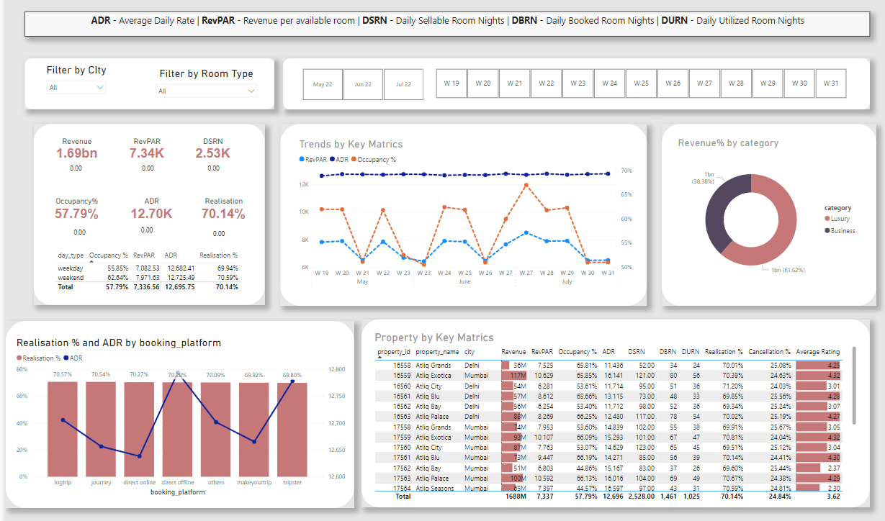
DASHBORD

Slide 7

Main KPIs
ADR - Average Daily Rate
RevPAR - Revenue per available room
DSRN - Daily Sellable Room Nights
DBRN - Daily Booked Room Nights
DURN - Daily Utilized Room Nights

Slide 8
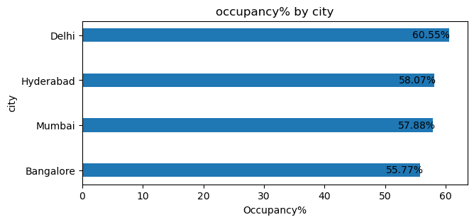
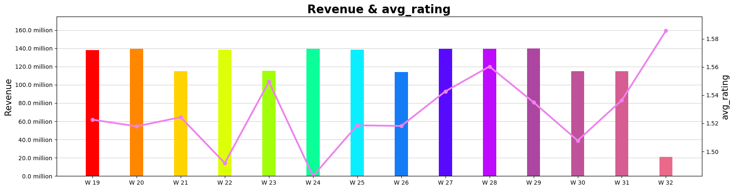
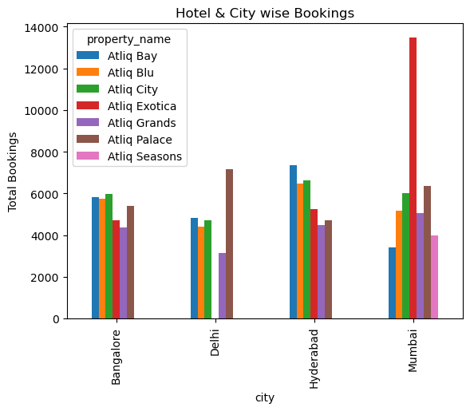
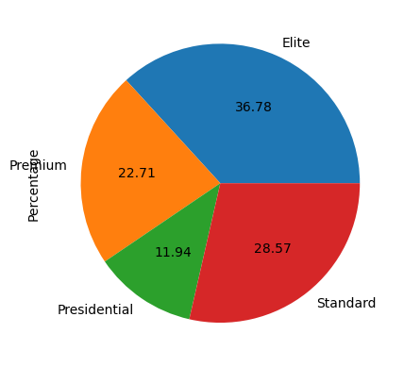
Infographs

Slide 9

SWOT Analysis
01
02
03
04
Strengths
Atliq Grands' core competencies, distinctive features, and competitive advantages position the brand for sustained success and market leadership.
Weaknesses
Areas of improvement, operational challenges, or market vulnerabilities that require strategic attention and mitigation to fortify the brand's position.
Opportunities
Emerging trends, market gaps, or untapped potentials that Atliq Grands can leverage to drive growth, expansion, and competitive advantage.
Threats
External factors, industry challenges, or market risks that pose potential obstacles to the brand's progress and necessitate proactive risk management strategies.

Slide 10

THANK YOU
SHAGUN WADHWA

